Slide 1
HF radar in Europe
Port management in Spain
E. Álvarez-Fanjul , M.G. Sotillo, M.I. Ruiz, P. Lorente
Notes:
Incluir la animación en dos fases

Slide 2
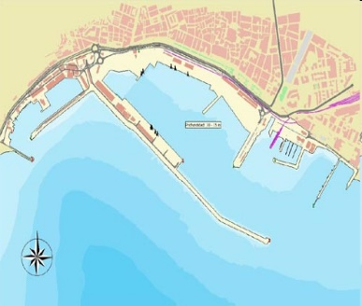
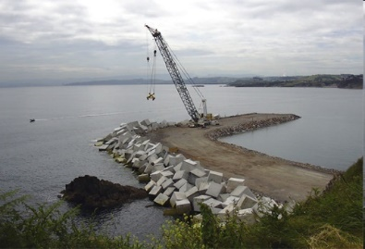
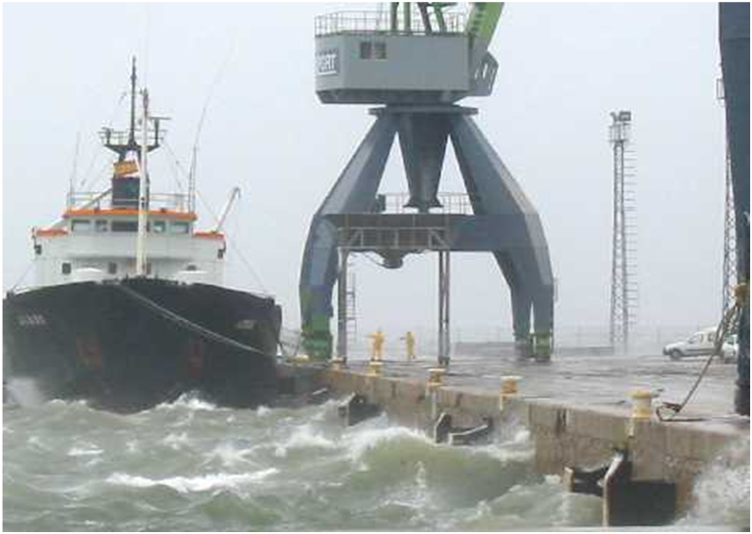
Puertos del Estado HF radar network
Ports need met-ocean info along all their life phases:
Design phase (viability, budget, execution plans,…)
Climatology description (from models & measurements) -> CMEMS Re-analysis and MY in-situ products.
Construction phase (safety, short-term build planning)
Real time alert systems and short-term Forecasts -> CMEMS In-situ & MFC (and downscaled) forecast systems
Exploitation phase (operations & port closing, piloting, environmental management, …)
Real time alert systems and short-term forecast -> CMEMS In-situ & MFC (and downscaled) forecast systems
Notes:
Incluir la animación en dos fases

Slide 3
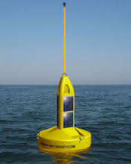
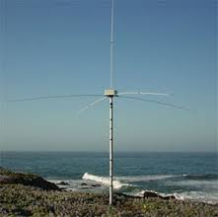
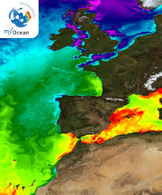
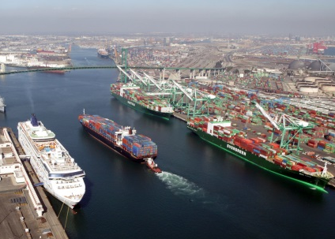
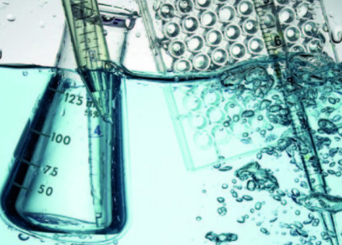
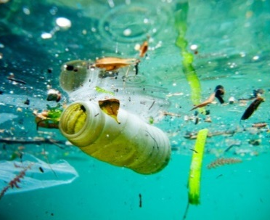
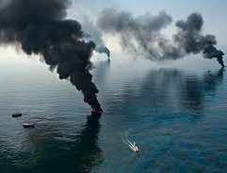
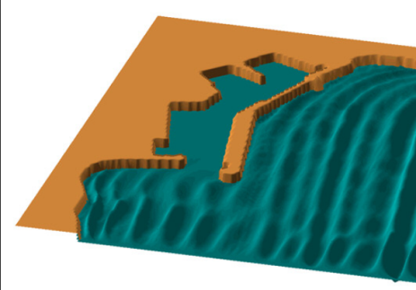
Puertos del Estado HF radar network
Comprehensive description of the coastal circulation
+
+
BUOYS
HF RADAR NETWORK
FORECASTING SYSTEMS
Real Time! Taylored products!
PORTS require an accurate knowledge of the circulation
Pilot operations Water quality Pollution Oil Spill
Current-Wave interaction
Notes:
Incluir la animación en dos fases

Slide 4
Puertos del Estado HF radar network
NETWORK: 4 HF radar systems
TIMELINE
EuroROSE (2000)
«pilot experience»
Prestidge (2002)
2 HF radar sites
Extension (+2) (2010)
New systems!
• Gibraltar (2010)
• Huelva-Algarve (2013)
• Ebro Delta (2014)
(2014-2015)
• 4 systems
• 14 sites
!
Largest HFR network in Europe!
Notes:
Incluir la animación en dos fases

Slide 5
Quality control of HF radar data
OBJECTIVE:
• Detection of malfunctions → «artefacts»
NONvelocity-based QC scheme
METHOD:
• Web tool + alert system
RESULTS RADIAL LEVEL: Ebro Delta (2014)
$Z= \frac{v−µ}{σ}$ $>2$
Z = normalized parameter
v = original parameter
µ = mean of v
σ = standard dev of v
Notes:
Incluir la animación en dos fases

Slide 6
Validation of HF radar data
TOTAL LEVEL
?
Analysis of velocity components
Zonal
Ebro Delta HF radar
6-month validation
Meridional
!
Discrepancies HF radar - buoy:
• Instrumental noise
• Mismatch in time sampling and averaging
• Distinct horizontal averaging scales
• Influence of vertical stratification
Notes:
Incluir la animación en dos fases

Slide 7
Applications:
1.- Distribution of HF radar data
• INSPIRE DIRECTIVE:
Discovery & View: PORTUS
Download
Intuitive georeferenced web interface
HF radar hourly total vector maps
Calendar-based access
2-D animations
Zoom levels
Notes:
Incluir la animación en dos fases

Slide 8
Applications:
1.- Distribution of HF radar data
• INSPIRE DIRECTIVE:
Discovery & View
Download (THREDDS - OPENDAP)
Near real-time service
Historical directory tree
THREDDS - OPeNDAP
+
Georeferenced files
NetCDF
Hourly total vectors
FREELY avalilable
+
+
PdE’s central repository
+
Descriptive metadata
HFR data
Web catalogue: http://opendap.puertos.es/thredds/catalog.html
Notes:
Incluir la animación en dos fases

Slide 9
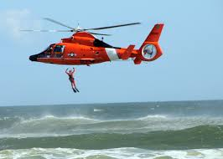
Applications:
2.- Search and Rescue (SAR) operations
SASEMAR: The Spanish marine Safety agency
HF radar data + IBI and SAMPA outputs
Daily Ingested by the Environmental Data Server (EDS)
Optimize SAR activities & oil pollution preparedness
Critical areas like the Strait of Gibraltar
Notes:
Incluir la animación en dos fases

Slide 10
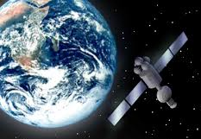
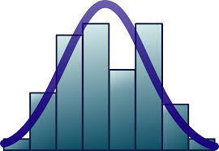
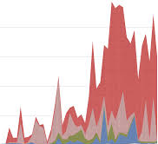
Applications:
3.- Validation of regional IBI model
• OBJECTIVE: Multi-parameter skill assessment software package
• NARVAL (North Atlantic Regional VALidation) web tool: IBI
• Routinely monitor IBI performance
Wealth of observational sources as benchmark:
QUID
HF radar as benchmark to validate the surface current field!
Notes:
Incluir la animación en dos fases

Slide 11
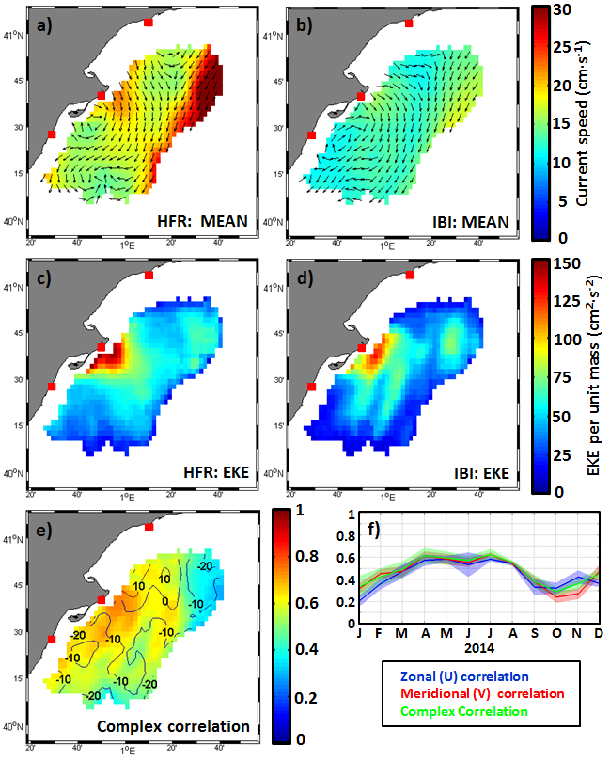
Applications:
3.- Validation of regional IBI model
!
Skill assessment of Operational Ocean Forecasting Systems
CMEMS context:
!
Integrate a synergistic data-model approach → Coastal circulation
Ebro Delta SPRING 2014
Further details…
Further details…
Notes:
Incluir la animación en dos fases

Slide 12
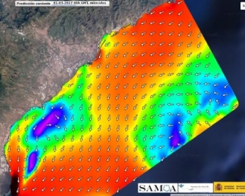
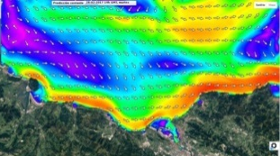
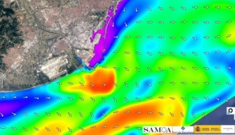
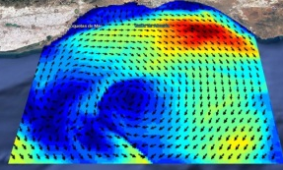
Applications:
4.- Validation of coastal nested models
CST-TEN
CST-FER
CST-BIL
CST-BAR
CST-PAL
CST-TAR
SAMOA PROJECT:
Ferrol
Bilbao
Tarragona
CST-GOM
Almeria
CST-ALM
CST-GCA
• NARVAL: INTERCOMPARISON OF MODEL SOLUTIONS
• IBI («father» system) versus High-resolution coastal models («sons»)
• Verify consistency of downscalling methodologies in port approach areas
• HF radar as bechmark tool in critical ports (Algeciras, Tarragona, etc.)
Notes:
Incluir la animación en dos fases

Slide 13
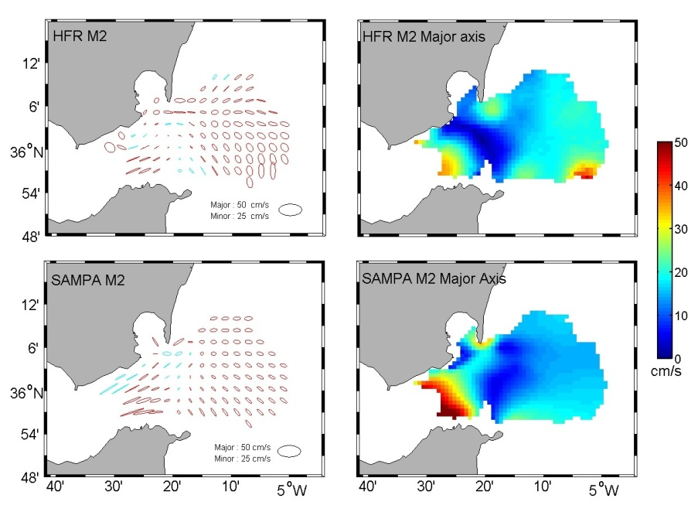
Applications:
4.- Validation of coastal nested models
• HF radars in port management:
COMPARISON (Gibraltar, February 2016)
1.2
0.9
0.6
0.3
0
IBI SAMPA HF RADAR
m/s
BLENDING (SAMPA + HF radar): enhance model predictive skills and get the best surface current estimate
M2
0 0.5 1 1.5
m/s
Notes:
Incluir la animación en dos fases

Slide 14
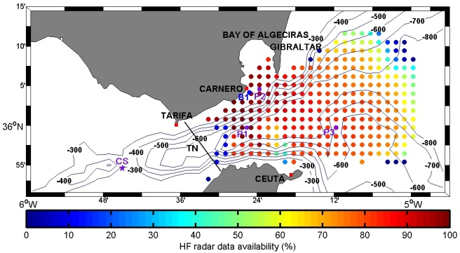
Applications:
4.- Validation of coastal nested models
• VALIDATION OF NESTED MODEL SYSTEMS: TIME SERIES ANALYSIS
JAN 2013 - OCT 2014
Near real-time monitoring of high-resolution coastal model´s skill and consistency!
 | P1 |  | P2
 | U | V | U | V
Hourly correlation | 0.70 | 0.27 | 0.54 | 0.29
30h running-mean correlation | 0.77 | 0.32 | 0.63 | 0.30
Notes:
Incluir la animación en dos fases

Slide 15
Applications:
5.- Validation of WAVE models
• Wave parameters extracted from the 2nd -order sea-echo Doppler spectrum
• 1st step: Accuracy assessment of Hs estimations provided by Galician HF radar (NW Spain)
Notes:
Incluir la animación en dos fases

Slide 16
Applications:
5.- Validation of WAVE models
• Wave parameters extracted from the 2nd -order sea-echo Doppler spectrum
• 1st step: Accuracy assessment of Hs estimations provided by Galician HF radar (NW Spain)
Specially useful when in situ data are NOT available
B2
Significant accuracy: peaks of Hs (> 8 m) clearly captured!
Notes:
Incluir la animación en dos fases

Slide 17
Applications:
5.- Validation of WAVE models
• Long-term assessment (2014-2016) of hourly HF radar Hs estimations
→ Variety of skill metrics
Long-term skill assessment of SeaSonde radar-derived wave parameters in the Galician coast (NW Spain) → Submitted to Journal of Remote Sensing
P. Lorente, A. Basañez, S. Piedracoba, V. Pérez-Muñuzuri, M.I Ruiz, M.G. Sotillo and E. Álvarez Fanjul
Notes:
Incluir la animación en dos fases

Slide 18
Applications:
5.- Validation of WAVE models
• CMEMS V3 release (April 2017): a new operational wave forecast system (10-km MF-WAM application): IBI-WAV
• NARVAL tool: ready to conduct a multi-parameter & multi-platform skill assessment of IBI-WAV
• HF radar: used as ancillary benchmark when situ time series from moorings are not complete
• 3-month wintertime validation of wave direction in Galicia: consistent!
Notes:
Incluir la animación en dos fases

Slide 19
Applications:
5.- Validation of WAVE models
• CMEMS V3 release (April 2017): a new operational wave forecast system (10-km MF-WAM application): IBI-WAV
• NARVAL tool: ready to conduct a multi-parameter & multi-platform skill assessment of IBI-WAV
• HF radar: used as ancillary data source when situ time series from moorings are not complete
• 3-month wintertime intercomparison of Hs in Galicia: IBI-WAV versus both buoy and HF radar
IBI-WAV QUID: end users
Notes:
Incluir la animación en dos fases

Slide 20
CONCLUSIONS
!
Implementation of a fully operational and permanent HFR network
ROADMAP:
!
HF radar network: working as a component of the entire observing system
!
NARVAL: multi-parameter & multi-platform skill assessment of IBI solutions (PHY + WAV)
!
HF radar data as benchmark for regional (IBI) and coastal/port scale models (SAMOAs)
Notes:
Incluir la animación en dos fases

Slide 21
FUTURE WORK & CHALLENGES
!
SAMOA II (2018-2021)
!
IBI: Data assimilation
Operacional: April 2018 (V4)
!
New systems → NARVAL
(Palma, Málaga, Gijón, etc.)
Validation against HF radar
(if possible)
!
CORA products:
ARGO floats
Satélite-derived SST data
Altimetry
Etc…
!
¿¿HF radar data assimilation??
More accurate (and skill assessed) forecasting of the current field
→Inform stakeholders about the quality of marine forecast products routinely delivered in CMEMS
→ Foster downstream services and user uptake
QUALITY–CONTROLLED HF RADAR DATA ARE AVAILABLE BUT…
…STRONG NECESSITY OF ADDED-VALUE TOOLS
Notes:
Incluir la animación en dos fases

